Slide 1

Movie-Based Lyric Generation
With Sentiment Classification
By: Nathaniel Oliver, Ian Bush, David Nguyen, Franchesco Velez, Georgi Nikolov
CAP 4630: Intro to Artificial Intelligence

Slide 2
The goal of this project is to create an AI that, given the name of a movie:
Extracts and analyzes the movie's plot to determine its emotional profile
Incorporates the movie's genre to refine its sentiment and themes
Generates song lyrics that reflect the movie's emotional and thematic characteristics.
Objectives

Slide 3


System Description
Dataset:
Our project utilizes the TMDB movie dataset uploaded by Hassan Raof on Kaggle.com.
AI Models Used:
In this project, a pre-trained Emotion Classification Model, created by Jochen Hartmann is used in order to “understand” and evaluate the sentiment of both the movie, in order to generate the lyrics, as well as the lyrics themselves.
For the lyrics generation, OpenAI’s model is used, and so an API key is needed.

Slide 4
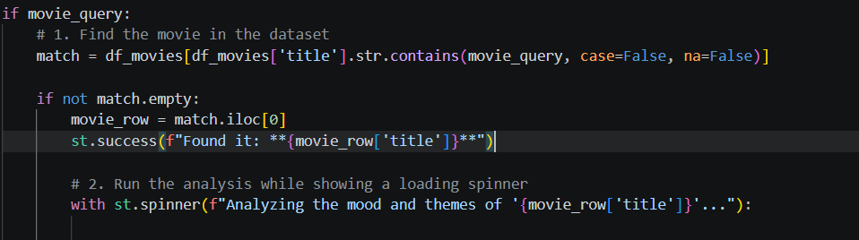
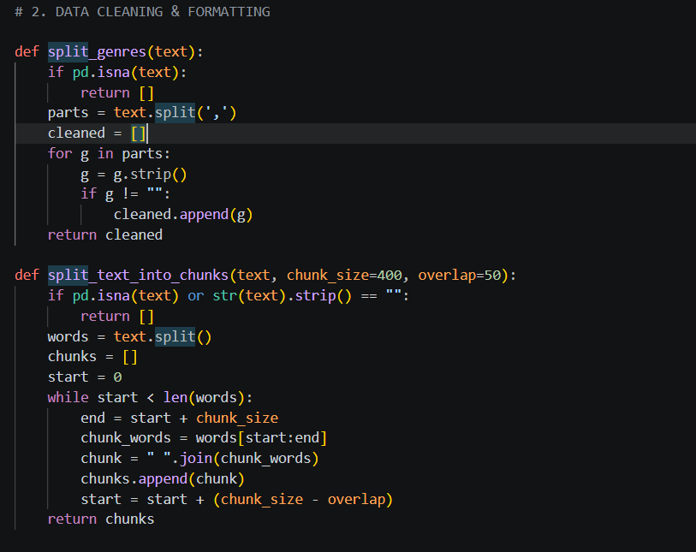
Methodology/Pipeline (contd.)
1. User Input/Data Retrieval: The user enters a movie title, and the title is searched for. If there is no match, "Movie not found in the TMDB dataset. Try another one!" is returned.
2. Data Preparation:
The genres of the movie are split and the overview or summary of the user’s chosen movie is split into chunks to be analyzed

Slide 5
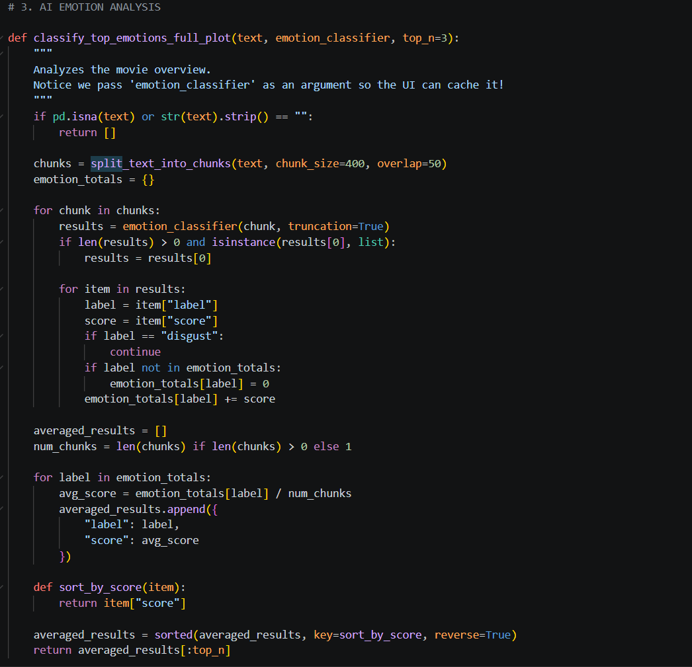
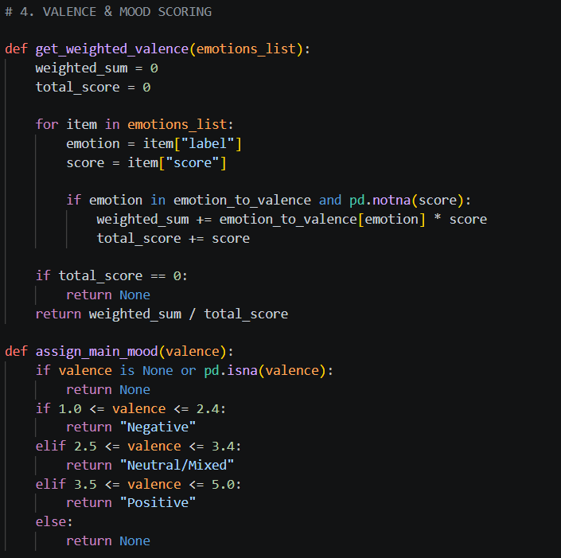
Methodology/Pipeline (contd.)
3. Emotional Analysis & Scoring:
Using the Emotion Analysis model, the chunks of text are analyzed, and then given an emotion score. From there, they are scored, scaled, and then the weighted average is taken in order to properly classify the emotions present

Slide 6
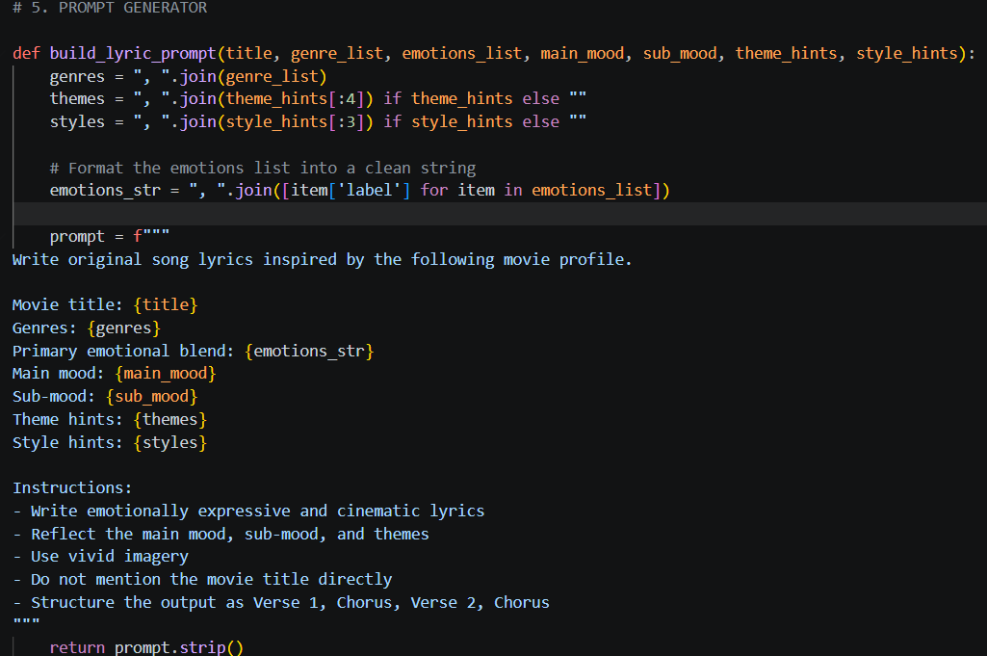
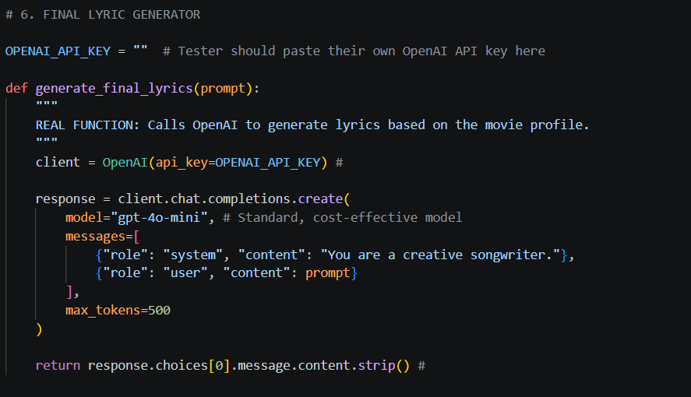
Methodology/Pipeline (contd.)
4. Prompt Generation:
The Promp for the OpenAI model is generated based on the moods from the analysis and classification, as well as the data from the TMDB dataset
5. Lyrics Generation:
The lyrics are generated accordingly with the promp, and are returned in real time.

Slide 7
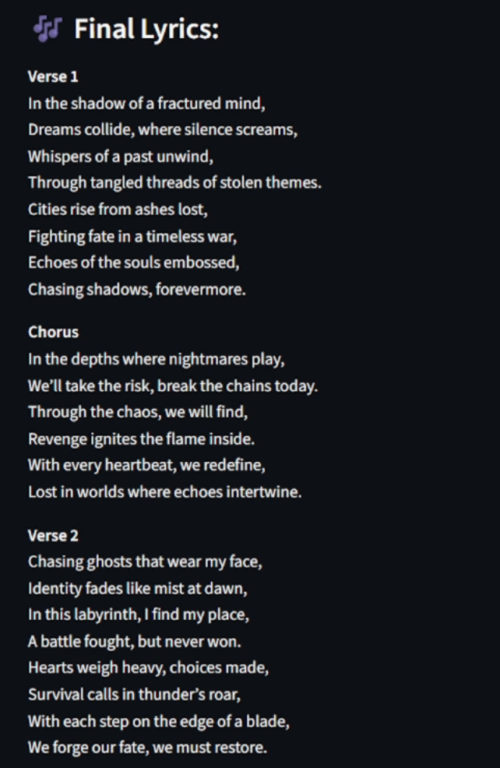
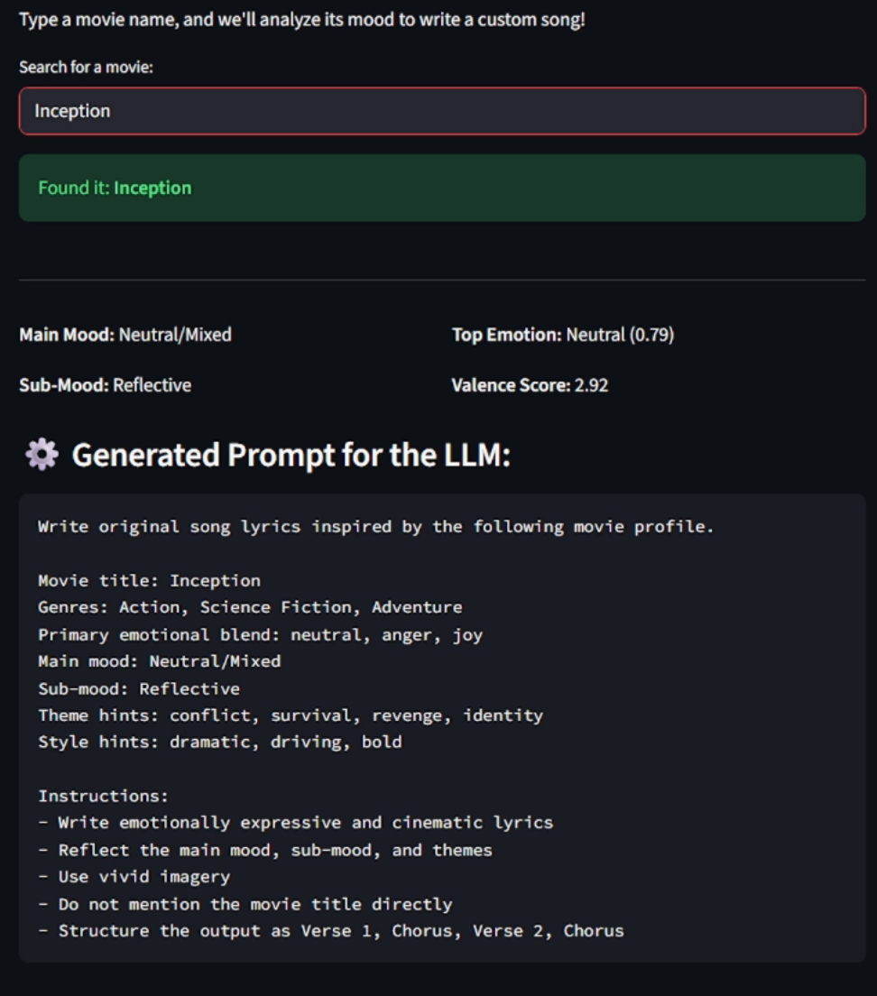
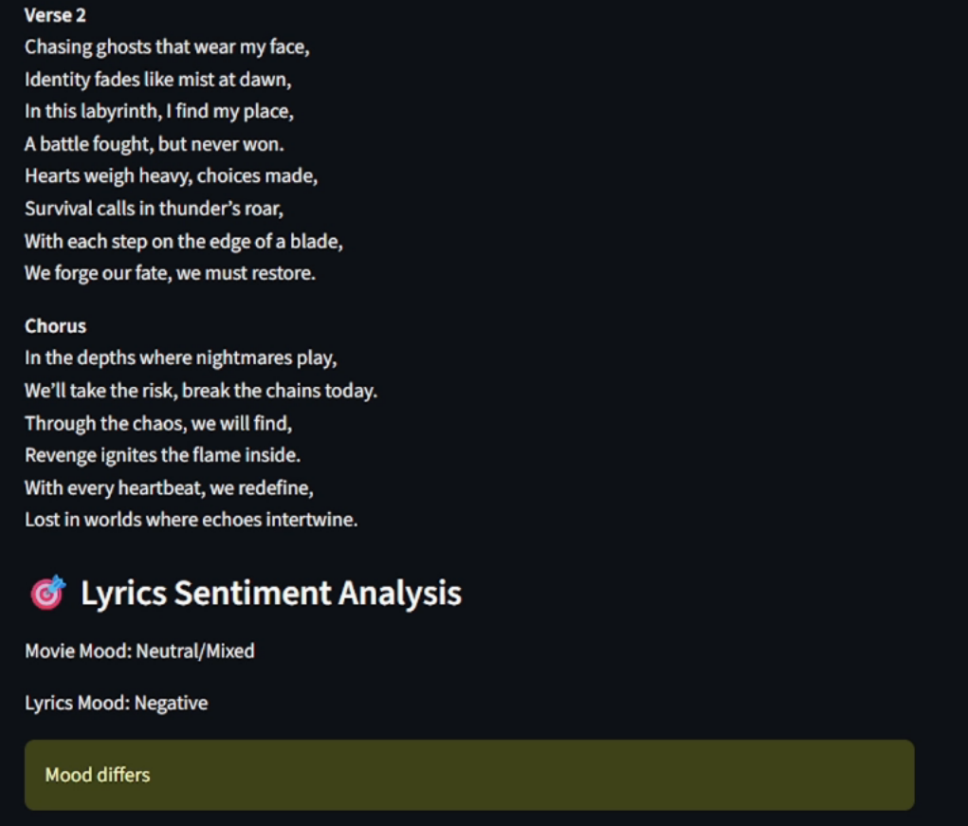
Visualization

Slide 8
Key Takeaways
Learned:
How to integrate models to analyze and classify data
How to clean and process data for Artificial Intelligence to utilize
How to combine multiple AI into one project
Possible Improvements:
Increase accessibility by finding a workaround for needing an API key to access OpenAI’s model
Improve the emotional evaulation of the model by traning it with more data, or replacing it with a more advanced model overall
Have a larger dataset for more movies to choose from
More in-depth user control (genre filter, diction control, song genre type, etc.)

Slide 9
References
Jochen Hartmann, "Emotion English DistilRoBERTa-base". https://huggingface.co/j-hartmann/emotion-english-distilroberta-base/, 2022.
Raof, Hassan. “Top10K-TMDB-Movies.csv.” Kaggle.com, 2024, www.kaggle.com/datasets/hassanraof/top10k-tmdb-movies-csv. Accessed 28 Apr. 2026.

